Slide 1
Systems Analysis
InfoSys 3810
Week Two
2013
Dr. Vicki Sauter and Friends
Professor, Information Systems
University of Missouri Saint Louis

Slide 2
Information Systems Analysis
Last week
Systems Analysis and Design is the art of problem solving.
Systems analysis is the study of a current business system and its problems, the determination and definition of business needs and information requirements, and the evaluation of alternative solutions.

Slide 3
Systems Analysis and Design
Last week
Systems Analysis … that part of the software development life cycle that deals with the study and structure (and analysis) of information systems requirements.

Slide 4
Systems Analysis and Design
Five fundamental, separable, yet interrelated elements
Planning … including requirements elicitation
Analysis
Design (including logical design and physical design ( or preliminary design and detailed design)
Implementation … which includes coding, test, and deployment
And
Maintenance

Slide 5
Systems Analysis and Design
The waterfall model … a sequential process where one phase is completed before the next is started …
There is significant formalism to this model
There is little actual use of this model in today’s Information Systems world

Slide 6
Systems Analysis and Design
The spiral model … analyze a little, design a little , code a little, implement a little … effectively a piecewise development of requirements and systems … ideal where requirements are not fully understood and must be ‘discovered’

Slide 7
Systems Analysis and Design
Modern (aka Agile) methods … including RAD, JAD, and ExtremeProgramming are all alternate life cycles with their own characteristics, strengths, weaknesses.

Slide 8
Systems Analysis and Design
Structured Methods … pioneered by Gane and Sarson and Yourdan and DeMarco are model driven methodologies

Slide 9
Systems Analysis and Design
Object Oriented Methods … designed based on the notion that the world can be represented by a series of objects, such as data, actions, entities, etc.

Slide 10
Systems Analysis … What is It?

Slide 11
Systems Analysis … A Definition
Systems Analysis is an explicit formal inquiry carried out to help someone identify a better course of action and make a better decision than he might otherwise have made.
Identification and re-identification) of objectives, constraints, and alternative courses of action
Enumeration of the probable consequences of the alternatives in terms of costs, benefits, and risks
Presentation of the results in a comparative framework so that the decision maker can make an informed choice from among the alternatives
Principia Cybernetica Web

Slide 12
Systems Analysis … But, What is a System?

Slide 13
Systems and Systems Analysis
Definition of a System
A system is a physical or logical entity composed of interacting parts that operate together to achieve some objective or purpose.
A system is intended to "absorb" inputs, process them in some way and produce outputs (where outputs are defined by goals, objectives or common purposes)
A system may be thought of as and entity which executes a transformation process

Slide 15
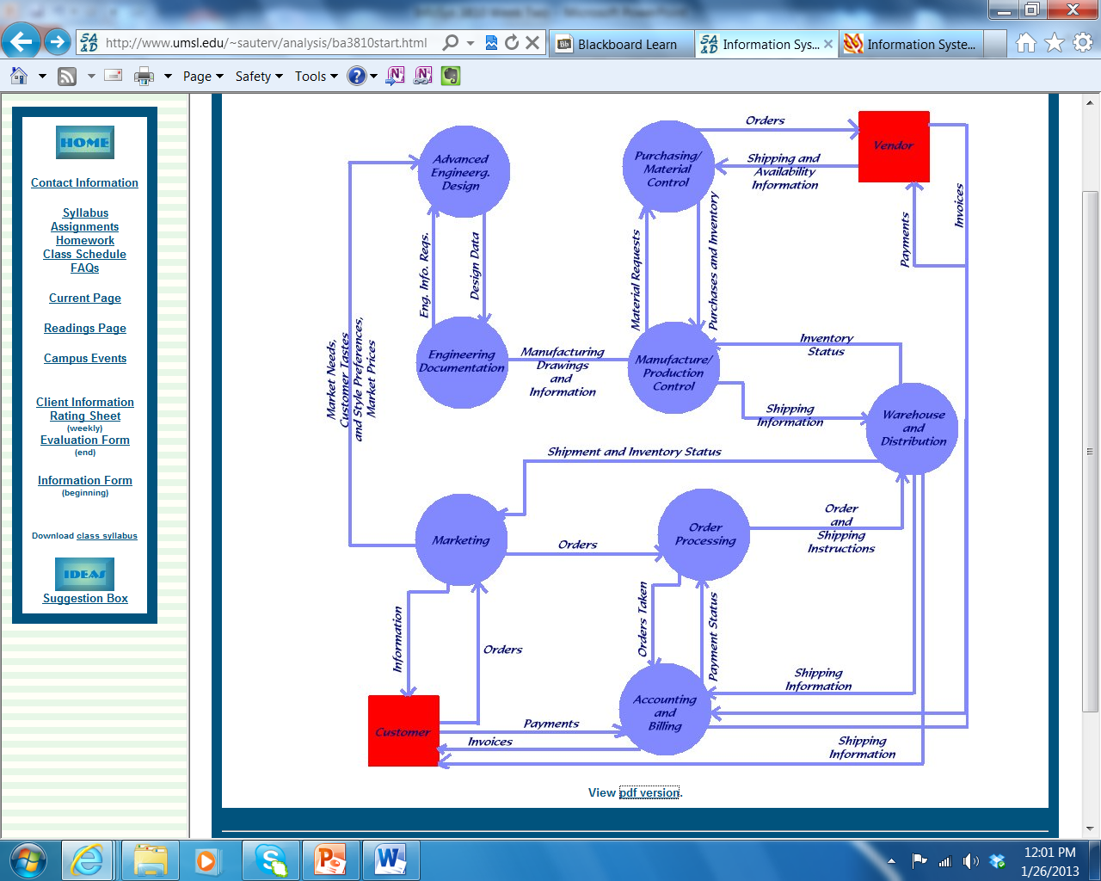

Slide 16
Systems and Systems Analysis
In order to understand the relationship between inputs, outputs and processes, you need to understand the environment in which all of this occurs.

Slide 17
Systems and Systems Analysis
The environment represents everything that is important to understanding the functioning of the system, but is not part of the system. The environment it is that part of the world that can be ignored in the analysis except for its interaction with the system. It includes: competition, people, technology, capital, raw materials, data, regulation and opportunities.

Slide 18
Systems and Systems Analysis
The boundary defines the difference between the environment and the system; the correct boundary is a function of the problem under consideration.

Slide 20
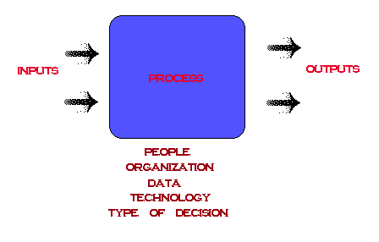

Slide 25
Some Systems Analysis Fables
The Astronomer
An astronomer used to go out at night to observe the stars. One evening, as he wandered through the suburbs with his whole attention fixed on the sky, he fell accidentally into a deep well. While he lamented and bewailed his sores and bruises, and cried loudly for help, a neighbor ran to the well, and learning what had happened said: "Hark ye, old fellow, why, in striving to pry into what is in heaven, do you not manage to see what is on earth?'
Moral: As a system analyst, one should not only pay attention on what are the perfect standards of a system should be, but also listen and aware of what the user of the system need and understand the limitation of the system.
These stories are adapted examples written in my class, IS 6840 (formerly MSIS 488). © Vicki L. Sauter. All rights Reserved.

Slide 26
Some Systems Analysis Fables
A Foolish Man Buys Shoes
In the past there lived a foolish man in a small kingdom called Zheng. One day he wanted to buy himself a pair of new shoes. He measured his feet with a ruler first and wrote down his size. But he was in such a hurry to set out that he left it at home. When he arrived at a shoe shop, he felt in the pocket only to find that it was not there. So he said apologetically, 'I have left the measurement at home and don't know the size. I'll fetch it in one minute.' With these words he hurried off as fast as his legs could carry him.
He ran back home, found it and then to the shop again. But still it took him quite a while and the shop was already closed then. He had gone to all this trouble for nothing and did not get his shoes.
Then someone asked him, 'Did you buy the shoes for yourself or someone else?' 'For myself, of course.' he answered. 'Then why don't you try the shoes on by yourself?'
Moral: Do not think the Zheng is so stupid. Nonetheless, we all have such a stupid time. My point is: System analysis and design is more like art than science. There are no established rules such as the ¡°measurement of feet¡± in system analysis and design. Thinking creatively and keep our mind open are very important in the process. In addition to thinking creatively, we should have customer, supplier, and some other people who may be helpful involve in the analysis and design phase to ensure that we can look at problems from different angles, not just close the door make our own “measurement”.
.

Slide 27
Some Systems Analysis Fables
The Lion's Party
A lion was the Kind of a Jungle. He used to organize parties and invited his favorite friends from other species of animals. To pick his invited friends he used to request services from other animals and judge their performance arbitrarily without predefined criteria. When he wanted to exclude an animal from the coming party he claimed that he did not get exactly what he wanted from that animal and that he was not satisfied with the services provided to him. And he would say: "That's not what I requested" and punished the animal by giving him some extra work to do without rewarding him and never invited him to the parties. Once he requested from a monkey to mimic the way a rabbit eats carrots. The poor monkey was trying to mimic how a rabbit eats carrots without using real carrots. The monkey was arguing that the lion did not say that the monkey has to use real carrots, but the lion was saying, "I meant that you have to eat carrots the way a rabbit eat it." And the lion punished the monkey by excluding him from the list of invited animals for the coming party. If the animal manages to perform well and the lion does not want him to be in the party he changes the formulation of his request and claim that the animal did not respond exactly to his request. A smart animal was trying hard to overcome the situation and was thinking of a way to make the lion make his requests clear and make him accept that a third party records the request and all details related to it, so that the lion won't claim that he was not getting what he requested, if a given animal manages to respond to the request accurately. First the lion refused to agree to this procedure but once he find out that this was hurting his reputation and it's giving a bad impression of the way he governs the jungle he accepted the new procedure and start to go by what it dictates. After the implementation of the new procedure all animals felt that they were pricked fairly and that there were no discrimination against any of them. They also worked hard to enhance their performance and go more productive so they can get the opportunity to go to the lion parties and enjoy being part of the elite invited.
Moral: A software development team might have a well established client that could be tough to deal with without signed agreements about what is that he wants and expects to get as a system. It's always wise to have a written and signed agreement that tie the two parties and goes in detail to what the client expects and how he wants it. The success of the development team would be then measured according to the specifications included in the agreement and any changes the client might suggest would have to be written and agreed on by the two parties.
.

Slide 28
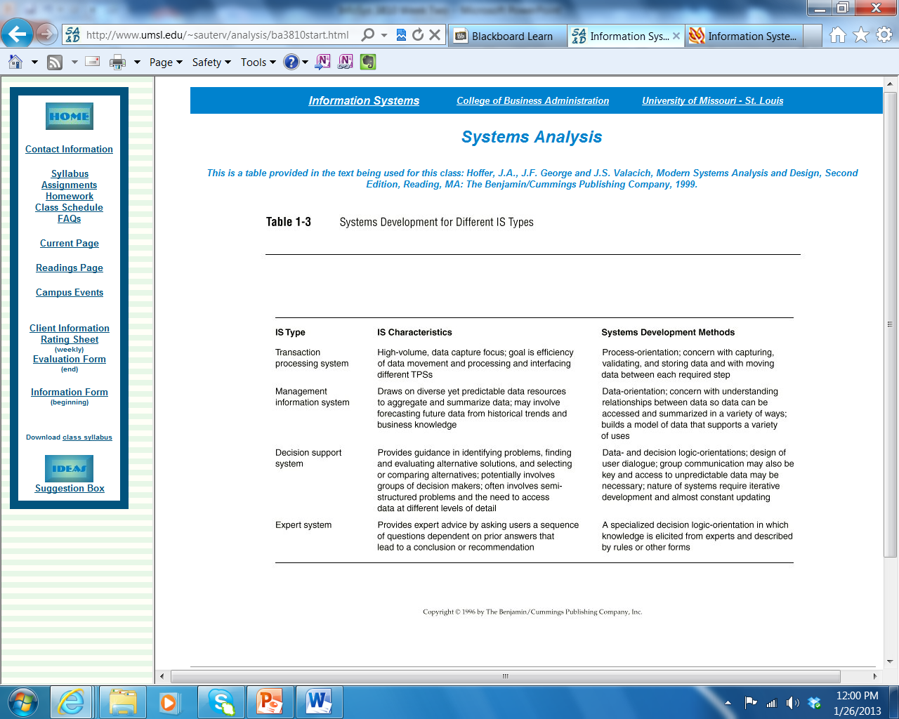

Slide 29
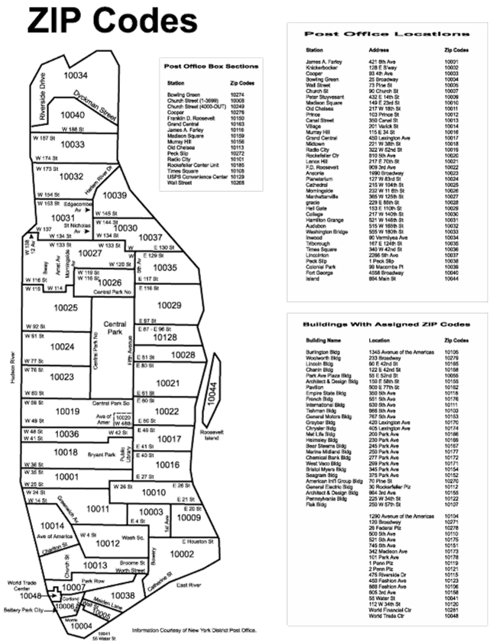
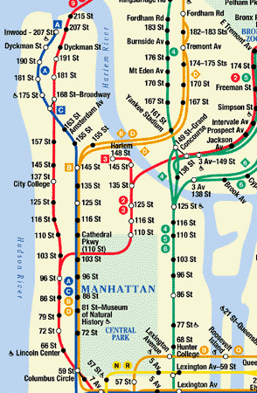
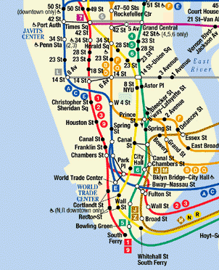
Different perspectives
… for different needs

Slide 30
Alternate Perspectives / Alternate Frameworks
Five alternate frameworks have significant followings in the business and academic areas
ARIS
ZACHMAN
DoD
FEA
TOGAF

Slide 31
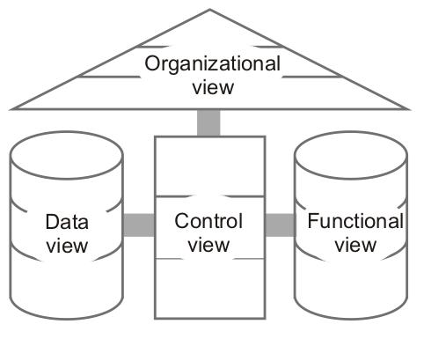
Architecture of Integrated Information Systems (ARIS)
Process View / Function View
Data view
Organizational View
Output View
Control View
Process View

Slide 32
Zachman Framework, Cont.
A framework for the orderly description of an enterprise … Created by John Zachman at IBM / Now in the public domain
Six Focus Areas
-- What -- How
-- Where -- Who
-- When -- Why
Six perspectives
-- Planner -- Owner
-- Designer -- Builder
-- Subcontractor -- User

Slide 33
Zachman Framework, Cont.

Slide 34
Business Rules
A business rule is a rule of a business, company, or corporation. It is a rule that defines or constrains some aspect of business and always resolves to either true or false. Business rules are intended to assert business structure or to control or influence the behavior of the business. Business rules describe the operations, definitions and constraints that apply to an organization. Business rules can apply to people, processes, corporate behavior and computing systems in an organization, and are put in place to help the organization achieve its goals.
Wikipedia.net

Slide 35
Business Rules, Cont.
For example a business rule might state that no credit check is to be performed on return customers.
Other examples of business rules include requiring a rental agent to disallow a rental tenant if their credit rating is too low, or requiring company agents to use a list of preferred suppliers and supply schedules.

Slide 36
Business Rules, Cont.
A business rule is a statement that defines or constrains some aspect of the business. It is intended to assert business structure or to control or influence the behavior of the business. The business rules that concern the project are atomic -- that is, they cannot be broken down further.
For our purposes, this may be viewed from two perspectives. From the business ('Zachman row-2') perspective, it pertains to any of the constraints that apply to the behavior of people in the enterprise, from restrictions on smoking to procedures for filling out a purchase order. From the information system ('Zachman row-3') perspective, it pertains to the facts that are recorded as data and constraints on changes to the values of those facts. That is, the concern is what data may, or may not, be recorded in the information system.
Businessrulesgroup.com

Slide 37
Looking Forward
Identify the business rules associated with circulation at the UMSL library.
DUE: January 30.

Slide 38
Looking Forward
Do something creative. Document it.
DUE: February 4.

Slide 39
Looking Forward
Write about your thoughts on not-for-profit organizations. In particular, you need to reflect on why not-for-profit organizations exist, what different kinds there are, and their role society. Finally, discuss any volunteer work you have done for any kind of not- for-profit organization.
DUE: February 20.

